Slide 1

AXA Driver Telematics Analysis
Ajay Deonarine
ajay.deonarine@aig.com
This version: January 5th, 2015 (first version: January 5th, 2015)
AIG is requesting confidential treatment and the information is being submitted pursuant to 12 U.S.C. §1828(x). AIG further requests that it be notified pursuant to FRBNY policy if the FRBNY is requested to disclose any information that AIG has shared with the FRBNY in its capacity as banking regulator and requests that it be afforded an opportunity to object to disclosure. This applies to all documents submitted in this and other related materials.
Notes:
ChartInfo.Set.Path: {\\livpwfs04\common\FrankSchmid\WorkCompXS4PCE\model};
ChartInfo.Set.DefaultScaleFactor: {0.60};
Macro, implemented by Frank Schmid, ERM, December 20, 2012

Slide 2
Executive Summary
Recent advances in data collection have created an opportunity to better price auto insurance
AXA (a major European insurance company) is hosting a competition on how to make best use of this data
Presented are the data and modeling techniques used to answer the their research question

Slide 3
Overview
Primer on Telematics
Exploring a New Telematic Application
Data
Modeling Methodology
Findings / Next steps
Appendix

Slide 4
Primer on Telematics

Slide 5
Relevance to Insurance More data to price risk
Conventional methods for pricing car insurance
Pooling customers by age, gender, driving history
These factors are identified with variation in loss potential
Insurers now install telematics devices on the insured’s automobiles
These devices can record data such as: time of day, miles driven, speed, braking, etc.
More data can price risk more effectively
Responsible drivers are rewarded for safe driving habits
Telemetrics is a technology that involves the automatic measurement and transmission of data from remote sources.
Telematics are an interdisciplinary field encompassing telecommunications, vehicular technologies, road transportation, road safety, electrical engineering, computer science.
Notes:
Speeding tickets, crashes, violations
Actuaries have correlated these factors with loss potential
Telematics includes but is not limited to GPS technology integrated with computers and mobile communications technology in automotive navigation systems.

Slide 6
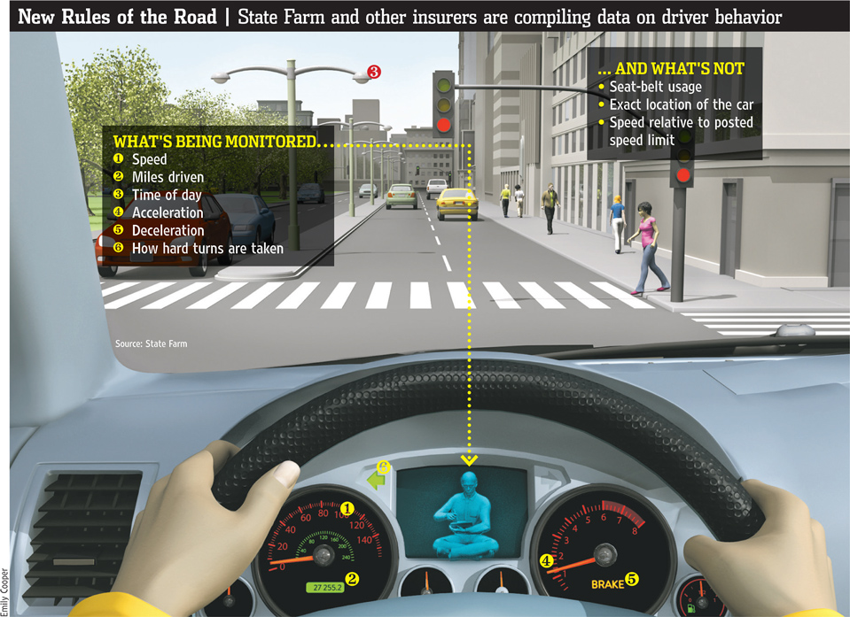
Telematics What’s currently monitored

Slide 7
Current state of Telematics In Insurance Industry
Progressive “Snapshot”
1.4 million drivers have signed up
Drivers can save up to 30% on premium
Allstate “Drivewise”
Downloading a mobile app or installing a small device in your car to track your safe driving habits could help you earn a savings of up to 30%
Statefarm “Drive Safe and Save”
Drivers can save up to 50% on premium
AXA “Drivology”
Premiums could go up, go down or stay the same!
Notes:
Varying granularity by country / state

Slide 8
Telematics in AXA Current State
AXA (Drivology) operating in the UK tracks all metrics including exact GPS coordinates
Premium is reviewed every 3 months
55% of customers have been advised of a forecast drop in premium averaging £35
30% forecast no change
15% a forecast increase in premium averaging £53
“For automobile insurers, telematics represents a growing and valuable way to quantify driver risk. Instead of pricing decisions on vehicle and driver characteristics, telematics gives the opportunity to measure the quantity and quality of a driver's behavior. This can lead to savings for safe or infrequent drivers, and transition the burden to policies that represent increased liability.”
Notes:
Presumably the service will be expanded to other (European countries)

Slide 9
Exploring A New
Telematic Application

Slide 10
Relevance Research Question
How often does a non policy holder drive the policy holder’s automobile?
If a policy is initially priced for one individual, can you tell if someone else drove?
Was someone else was driving while involved in an accident?
A policy issued for me, how often does my wife drive?
How often does my reckless teenage child drive?
By identifying periods of time where the “driver finger print” does not match that of the policyholder, we seek to identify different drivers
And subsequently price accordingly
Notes:
The frequency to which other drivers drive the main policy holder’s car

Slide 11
Problem Description Using telematic data to identify a driver signature
“For this competition, Kaggle participants must come up with a ‘telematic fingerprint’ capable of distinguishing when a trip was driven by a given driver. The features of this driver fingerprint could help assess risk and form a crucial piece of a larger telematics puzzle.”
The dataset contains 547,000 anonymized driver trips
2736 drivers each with 200 trips
A “small and random number” of false trips (trips that were not driven by the driver of interest) are planted in each driver's trip inventory
These false trips are sourced from drivers not included in the competition
You are not given the number of false trips (it varies), nor a labeled training set of true positive trips

Slide 12
Exploring A New
Telematic Application:
Data

Slide 13
Data Description Using telematic data to identify a driver signature
Unit of observation is the trip of an individual car
For each trip the car’s location is captured once per second
Data is strictly position relative to starting location
Time is measured as seconds from trip start
The challenge of this competition is to identify trips which are not from the driver of interest, based on their telematic features
You must predict a probability that each trip was taken by the driver of interest
Notes:
Time is measured relative to start of each trip
Don’t know time of day

Slide 14
Data Challenges Not true GPS coordinates
For privacy reasons, data is highly anonymized
Trips are re-centered to (0,0)
Trips are randomly rotated
No true time stamps – all time is relative to start of trip
No diver demographics
Use of external data is not allowed (though probably not useful)
Actual anonymization description is vague, most likely on purpose
GPS data is quite volatile due to:
Coverage area
Tunnels
Inclement weather
Notes:
Time of day would be a good indicator of who’s driving

Slide 15
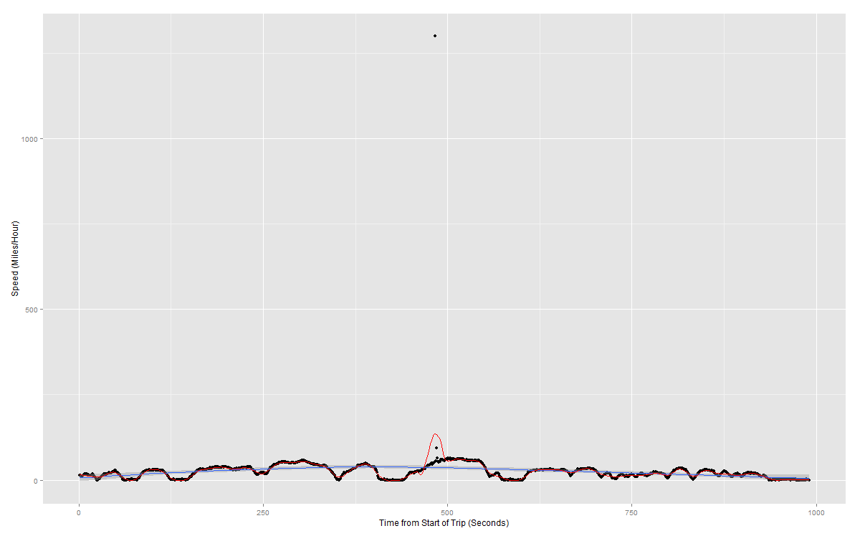
Example: Driver 1 / Trip 200 Raw Speed
Notes:
Blue:loess span = .75
Red:loess span = .05

Slide 16
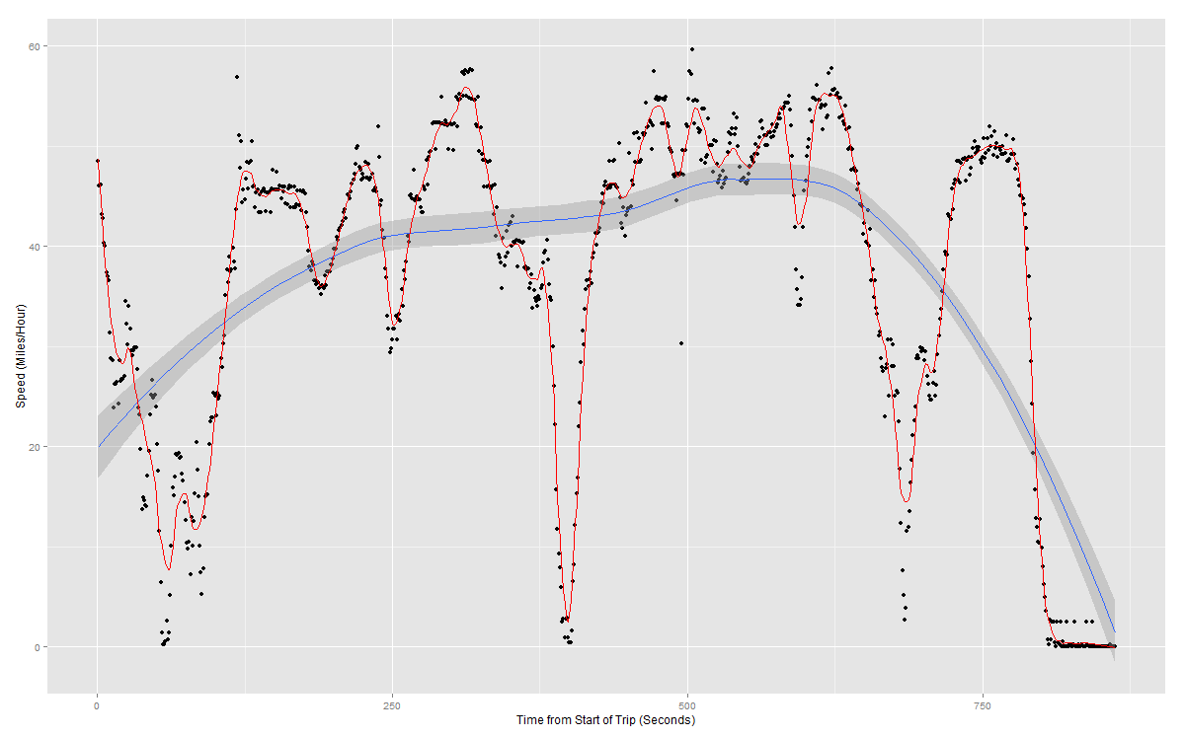
Example: Driver 1 / Trip 1 Loess Smoothing Speed
Notes:
Blue:loess span = .75
Red:loess span = .05

Slide 17
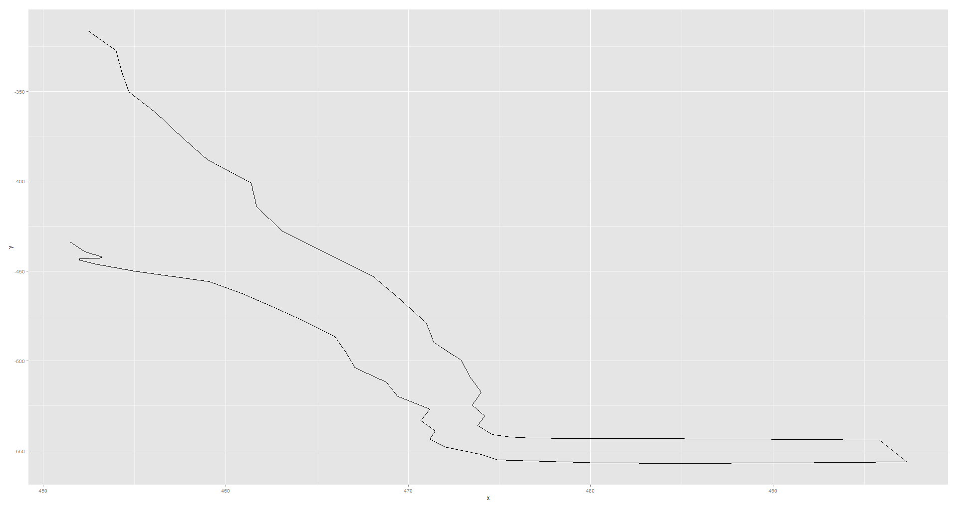
Example: Driver 1 / Trip 1 Raw Location
Notes:
How to count turns

Slide 18
Data Challenges
How to handle outliers?
Remove or smooth
Automatic removal is hard and risks eliminating pertinent information
Loess or kernel smoothing involves setting parameters to control degree of smoothing
How to count turns in presence of choppy GPS readings?
Left turns, right turns, U-turns
Smooth in polar coordinates
Sample position every 10/30 seconds

Slide 19
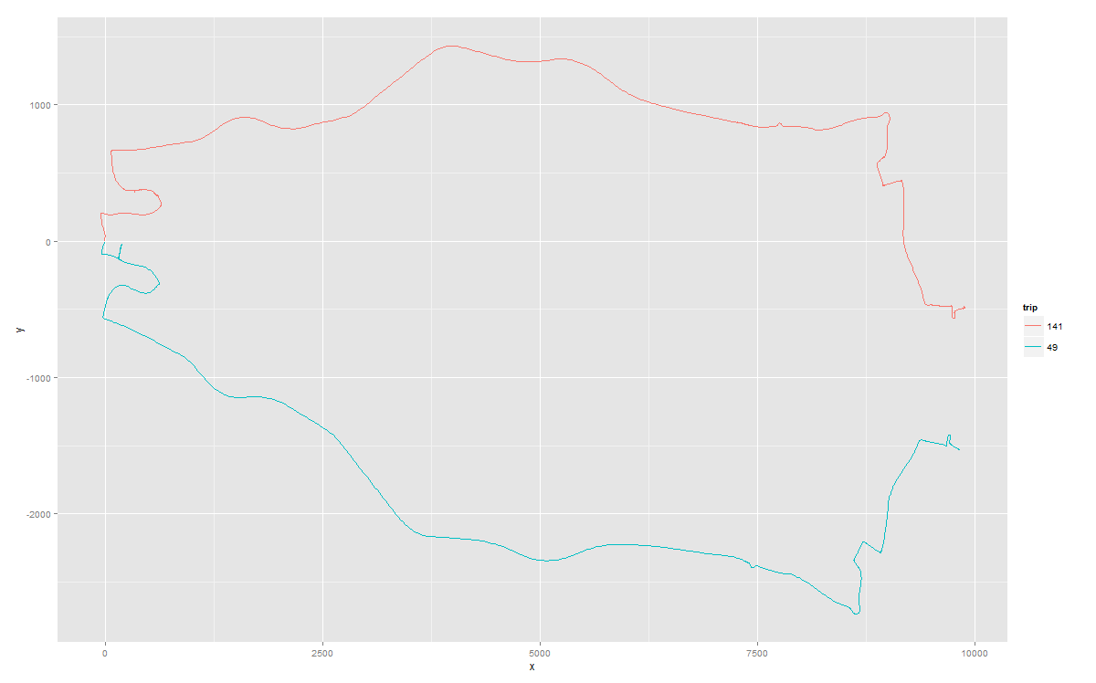
Example: Driver 1 Raw Location
Notes:
How to count turns

Slide 20
Exploring A New
Telematic Application:
Methodology

Slide 21
Decision Trees
Handle large datasets
Handle mixed predictors – quantitative and categorical
No need to create dummy variables
Ignore redundant variables
Handle missing data
Usually poor performance on their own – high variance
Tendency to overfit
Not the best prediction performance
A deep enough tree can fit data perfectly

Slide 22
Leveraging Trees To improve performance
Bagging
Reduce variance through average many trees (if uncorrelated)
Boosting
Learn from the errors of previous classifier
GBM is Boosting in the context of trees
Trees are grow sequentially building on the residuals of the previous tree
Final model is the sum all tree predictions
Notes:
See Appendix

Slide 23
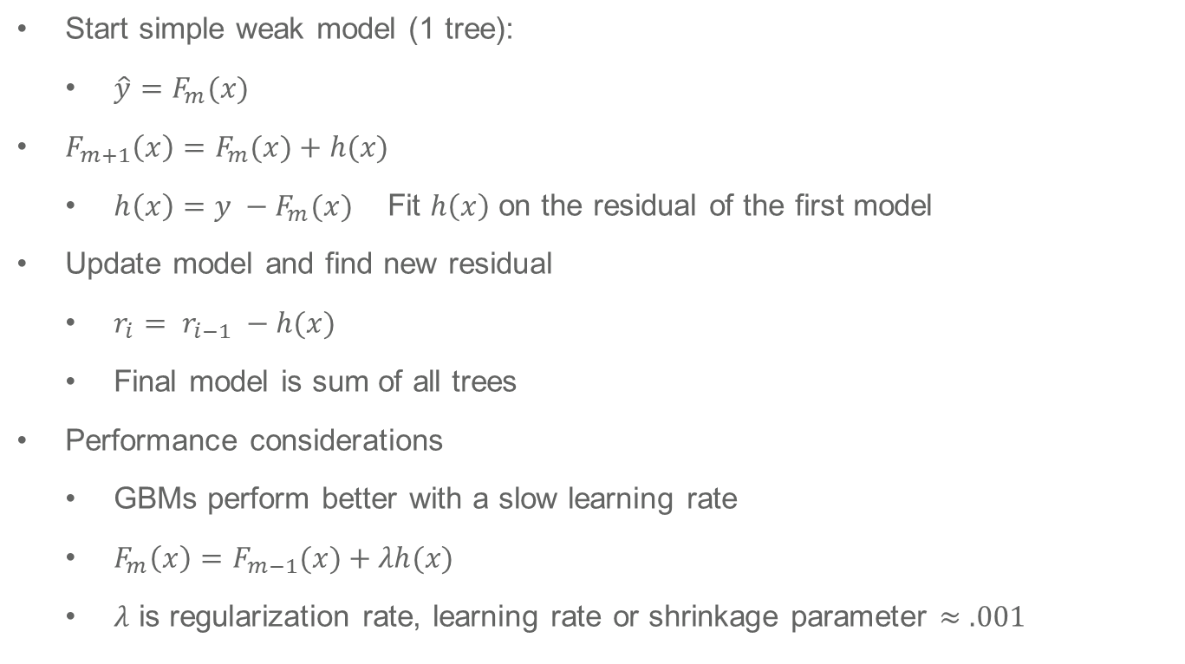
GBM Overview
Start simple weak model (1 tree):
$\hat{y}=F_{m}(x)$
$F_{m+1}\left(x\right)=F_{m}(x)+h(x)$
$h\left(x\right)=y −F_{m}(x)$ Fit $h\left(x\right)$ on the residual of the first model
Update model and find new residual
$r_{i}= r_{i−1} −h(x)$
Final model is sum of all trees
Performance considerations
GBMs perform better with a slow learning rate
$F_{m}\left(x\right)=F_{m−1}(x)+λh(x)$
$λ$ is regularization rate, learning rate or shrinkage parameter $≈.001$
Notes:
Can choose to minimize any loss function Small learning rate leads to growing many more trees

Slide 24
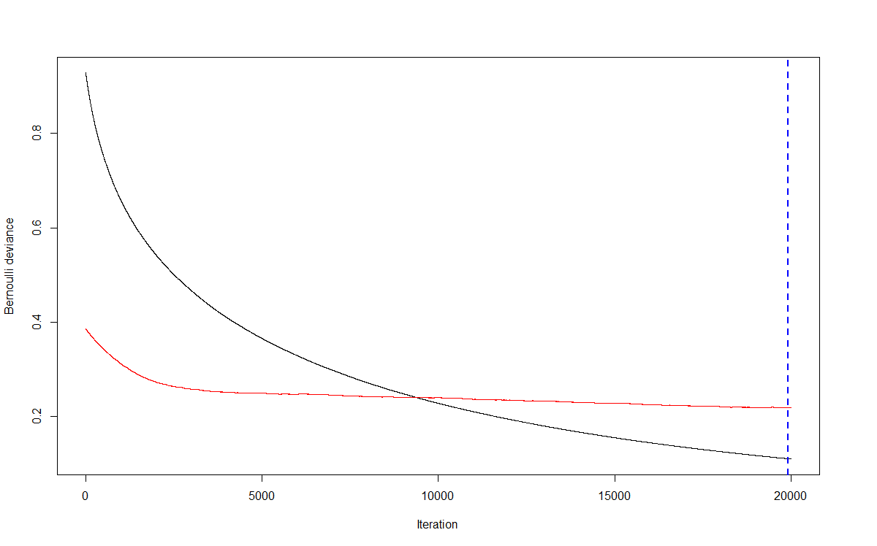
GBM Tuning
Must set number of trees to grow at onset
Optimal number of small trees in final classifier GBM is set via a validation hold out ~25% of data
Training Set
Test Set
Notes:
Drawbacks are Model doesn’t use all data to create model.
Can re-sample and blend, i.e., Cross Validation to use all available data points

Slide 25
Model Considerations
Overfitting
Not a huge concern
Very hard to overfit such a large dataset
Feature generation
Embarrassingly parallel task
Process ~500 Million trips in < 2 hours
Modeling driver trip probabilities parallelizes as well
A top 25% model score all the data in ~2 hours
A top 10% model can score all the data in ~5 hours
Incremental improvements involve an exponential increase in processing time
Running and blending multiple GBMs
Notes:
See Appendix

Slide 26
Findings / Next Steps
Discussion Points

Slide 27
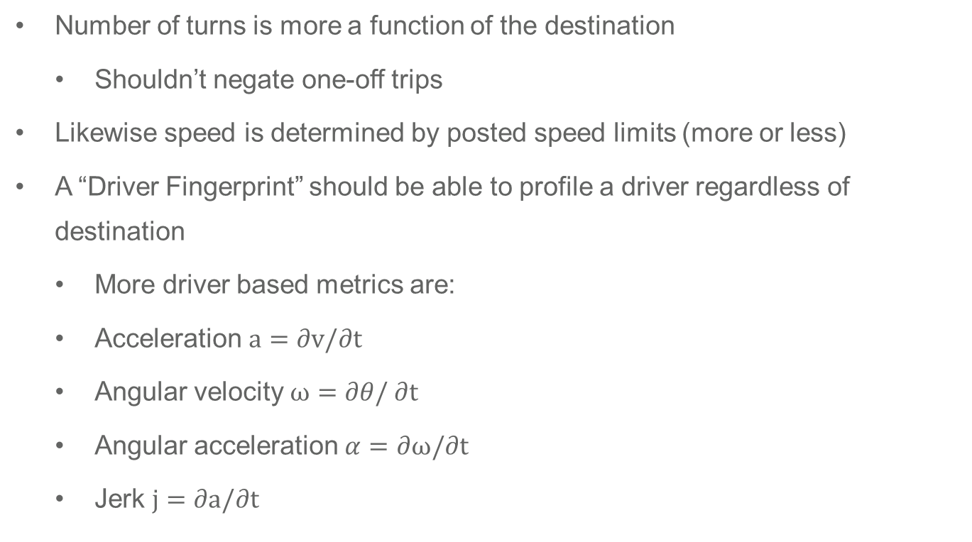
Findings Predictors of “Driver Fingerprint”
Number of turns is more a function of the destination
Shouldn’t negate one-off trips
Likewise speed is determined by posted speed limits (more or less)
A “Driver Fingerprint” should be able to profile a driver regardless of destination
More driver based metrics are:
Acceleration $a=∂v/∂t$
Angular velocity $ω=∂θ/∂t$
Angular acceleration $α=∂ω/∂t$
Jerk $j=∂a/∂t$
Notes:
Crux of problem.
Less path dependent

Slide 28
Results Predictors of “Driver Fingerprint”
Where you go matters less
Back roads, highways are more a function of where a driver is going
Commuting patterns may be useful
Turns are distorted due to anonymization
How you get there is the key indicator
Turning velocity and acceleration are more indicative of how someone drives, regardless of the destination
Driving style coupled with real GPS coordinates is the ideal dataset
Can compare and contrast drivers on the same road
Or on same day / time
Can merge in speed limits and weather considerations
Notes:
Crux of problem.
Less path dependent

Slide 29
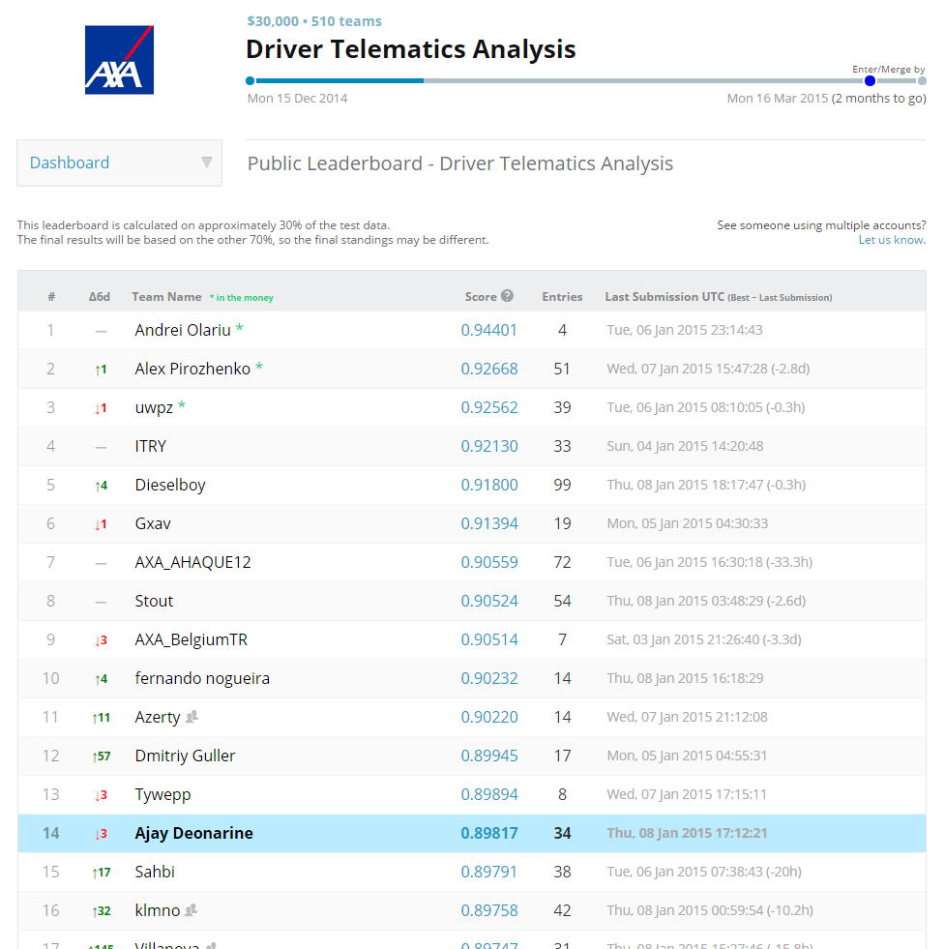

Slide 30
Future Possible Usage
Auto telematics is nascent field (few) insurers are exploring.
What are the cost effective uses?
Can we predict loss / loss size on driving characteristics?
What driving habits are most loss prone?
Automatically charge premium (monthly / quarterly) based on usage
Miles driven
Automatically detect family member driving and charge accordingly
Are you subsidizing bad drivers?
Premium based on driving habits is more fair
Some young drivers are good drivers and shouldn’t be penalized

Slide 31
Resources

Slide 32
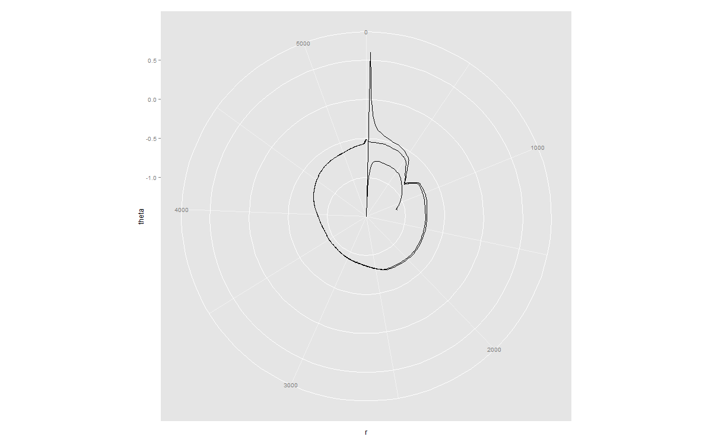
Example: Driver 1 / Trip 1 Raw Location – Polar Transformation
Notes:
How to count turns

Slide 33
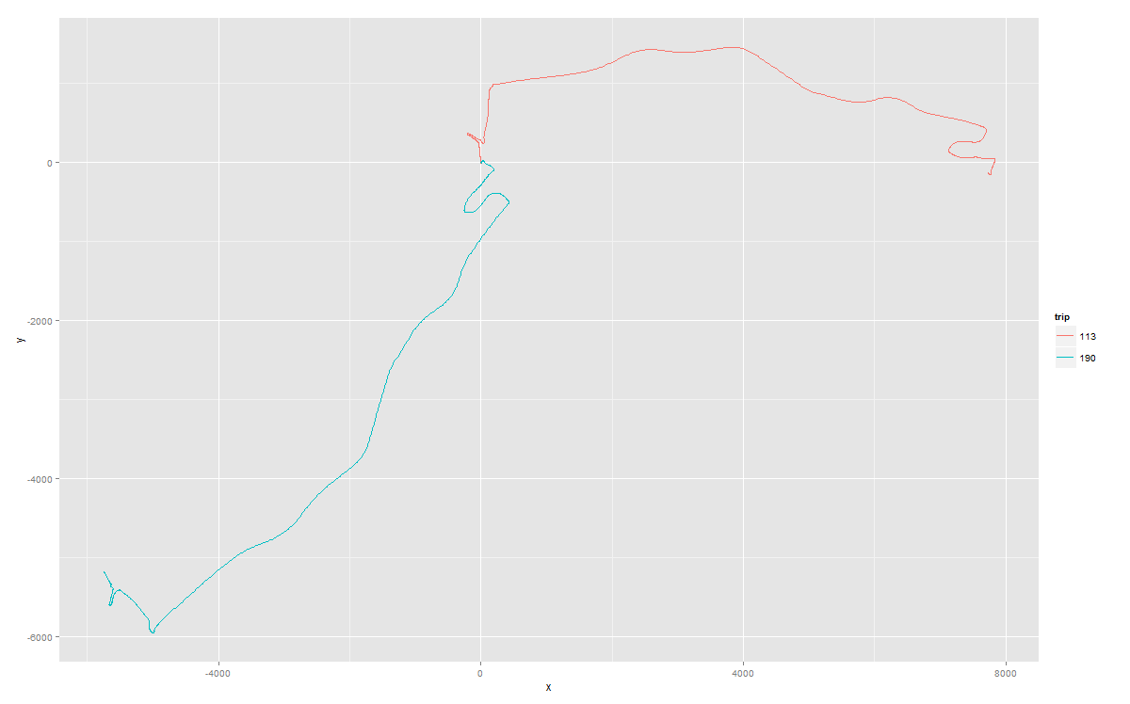
Example: Driver 1 Raw Location
Notes:
How to count turns

Slide 34
Resources
AXA drivology
http://www.drivology.co.uk/howitworks
Smoothing Methods to Minimize Impact of Global Positioning System Random Error on Travel Distance, Speed, and Acceleration Profile Estimates
http://www.transportation.ce.gatech.edu/sites/default/files/files/smoothing_methods_designed_to_minimize_the_impact_of_gps_random_error_on_travel_distance_speed_and_acceleration_profile_estimates-trr.pdf
State Farm Is There: As You Drive
http://www.wsj.com/articles/SB10001424127887323420604578647950497541958
https://www.statefarm.com/insurance/auto/discounts/drive-safe-save

Slide 35
Resources
Progressive “Snapshot”
http://www.progressive.com/auto/snapshot/
Allstate “Drivewise”
http://www.allstate.com/tools-and-resources/car-insurance/telematics-device.aspx
http://www.allstate.com/auto-insurance/auto-insurance-discounts.aspx
http://www.allstate.com/drive-wise.aspx

Slide 36



Appendix Reduce variance through averaging

Slide 37
American International Group, Inc. (AIG) is a leading international insurance organization serving customers in more than 130 countries and jurisdictions. AIG companies serve commercial, institutional, and individual customers through one of the most extensive worldwide property-casualty networks of any insurer. In addition, AIG companies are leading providers of life insurance and retirement services in the United States. AIG common stock is listed on the New York Stock Exchange and the Tokyo Stock Exchange.
AIG is the marketing name for the worldwide property-casualty, life and retirement, and general insurance operations of American International Group, Inc. Products and services are written or provided by subsidiaries or affiliates of American International Group, Inc. Not all products and services are available in every jurisdiction, and insurance coverage is governed by actual policy language. Certain products and services may be provided by independent third parties. Insurance products may be distributed through affiliated or unaffiliated entities. Certain property-casualty coverages may be provided by a surplus lines insurer. Surplus lines insurers do not generally participate in state guaranty funds and insureds are therefore not protected by such funds.
American International Group, Inc. (AIG) is a leading international insurance organization serving customers in more than 130 countries and jurisdictions. AIG companies serve commercial, institutional, and individual customers through one of the most extensive worldwide property-casualty networks of any insurer. In addition, AIG companies are leading providers of life insurance and retirement services in the United States. AIG common stock is listed on the New York Stock Exchange and the Tokyo Stock Exchange.
AIG is the marketing name for the worldwide property-casualty, life and retirement, and general insurance operations of American International Group, Inc. Products and services are written or provided by subsidiaries or affiliates of American International Group, Inc. Not all products and services are available in every jurisdiction, and insurance coverage is governed by actual policy language. Certain products and services may be provided by independent third parties. Insurance products may be distributed through affiliated or unaffiliated entities. Certain property-casualty coverages may be provided by a surplus lines insurer. Surplus lines insurers do not generally participate in state guaranty funds and insureds are therefore not protected by such funds.

